Slide 1
Music Box Churn User Prediction
Jiahao Wang

Slide 2
Background
Significant user loss from April 22nd to May 12th
Approximately 400 thousand users from March 30th to April 21st v.s. 200 thousand users from April 22nd to May 12th
50% User Loss
Business Problem
Identify churn user: inactive users (<3 play times) from April 22nd to May 12th who were active from March 30th to April 21st
Business Objective
Predict users activity level based on user behaviors
Use business strategy to prevent future customer loss

Slide 3
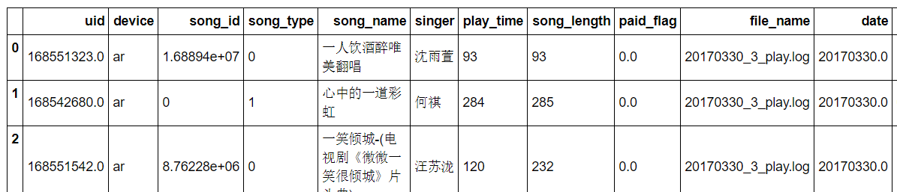
Data Overview
Each row represents a music playing activity
User matrix used for data modeling

Slide 4
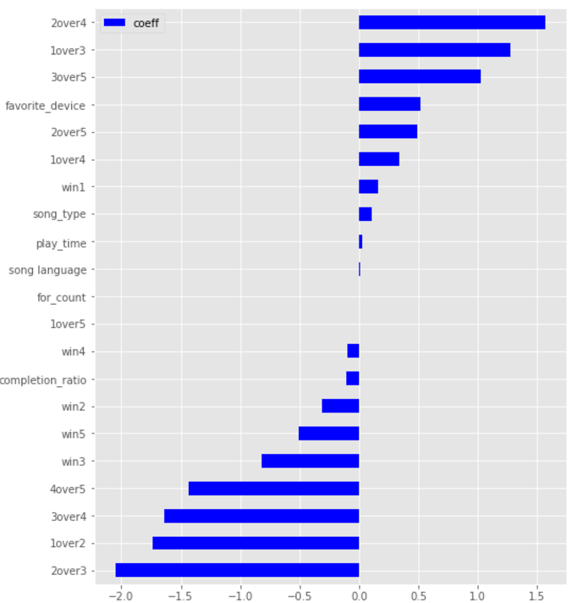
Data Modeling
Random Forest Classifier
GridSearch for tuning max features, n estimators, etc.
Features with high coefficients: Play times from April 19th to April 21th
5 Time related features v.s. 6 User preference features
Accuracy: 0.78 for training set and 0.76 for testing set
Logistic Regression
Time related features have higher coefficients
Accuracy: 0.74 for training set and 0.73 for testing set
Model Improvement
Refine features
More model performance measurements

Slide 5
Conclusion
Business Strategy to Avoid User Loss
Offer benefits to predicted churn users
Identify reasons for user loss
A\B testing for user preference
Music Box application update
Future Work
User’s Recommender System

Slide 6
Thanks

